Slide 1
Emotion
Dr J Balamurugan

Slide 2
Introduction
Emotions use an incredibly powerful force on human behavior.
It add colour to living.
Its like spice without which life would be dull.
But, often the emotions become sour, because these put the man in trouble.
For example, when a man is intense emotions, his judgements are disturbed, friends become enemies and life turns miserable.
Hence, emotions are both energizing as well as enervating.
“Emotions is both organizing (making behaviour more effective) and disorganizing” - Hebb Do.

Slide 3
Definition
In psychology, emotion is often defined as a complex state of feeling that results in physical and psychological changes that influence thought and behavior.
By emotion we mean a subjective feeling state involving physiological arousal, accompanied by characteristic behaviours. – Baron, Byrne & Kantowitz.
Human emotion involves "...physiological arousal, expressive behaviors, and conscious experience." - David G. Meyers

Slide 4
Characteristics of Emotion
Emotion is diffused
Emotion is persistent
Emotion is cumulative
Often emotions are motivational in nature

Slide 5
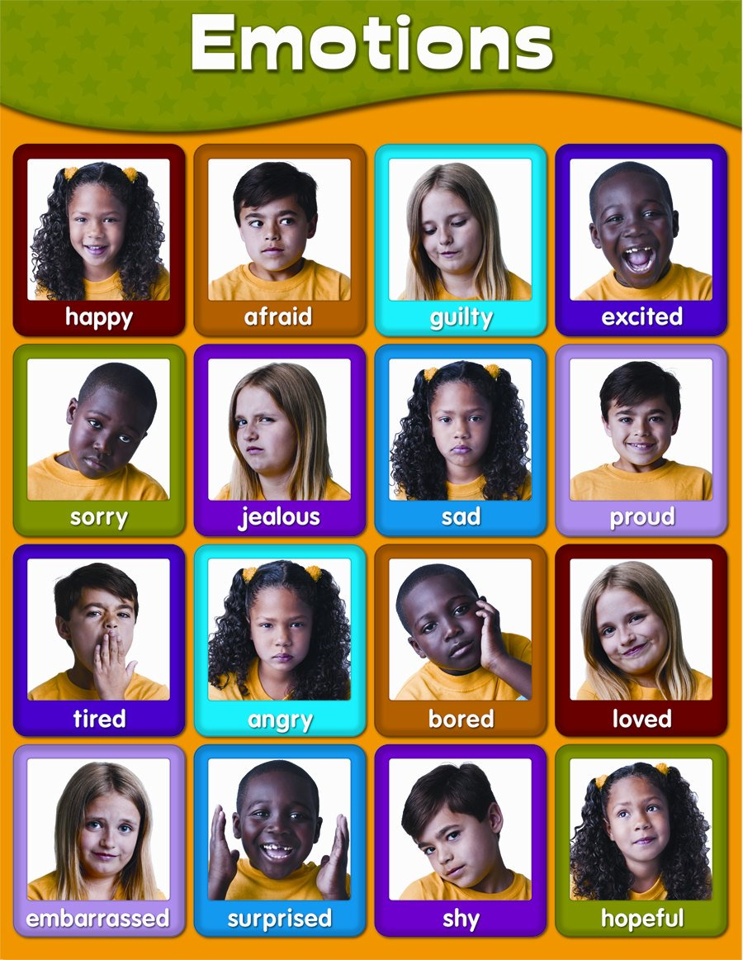

Slide 6
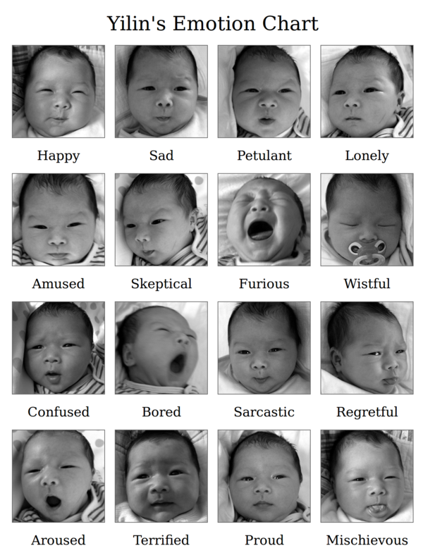
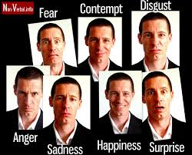
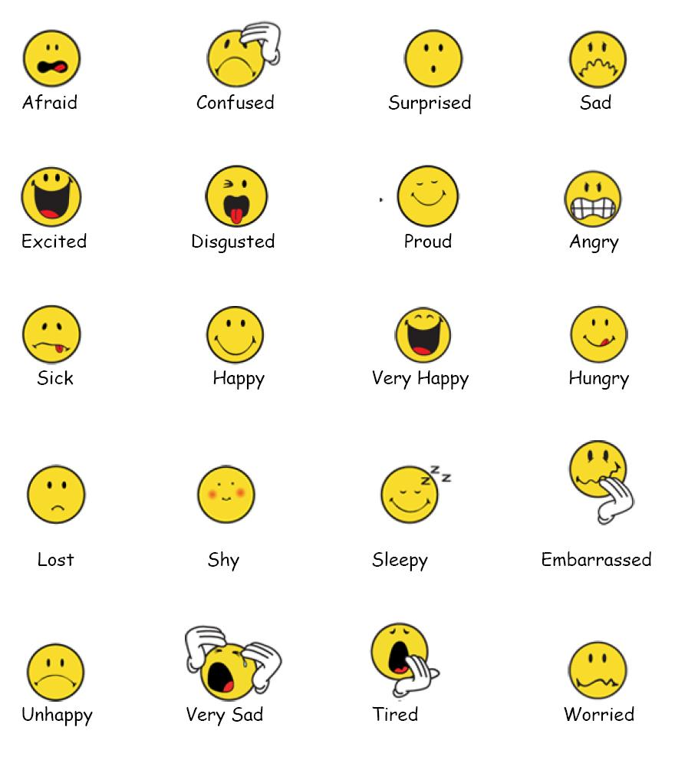
Kind of Emotions

Slide 7
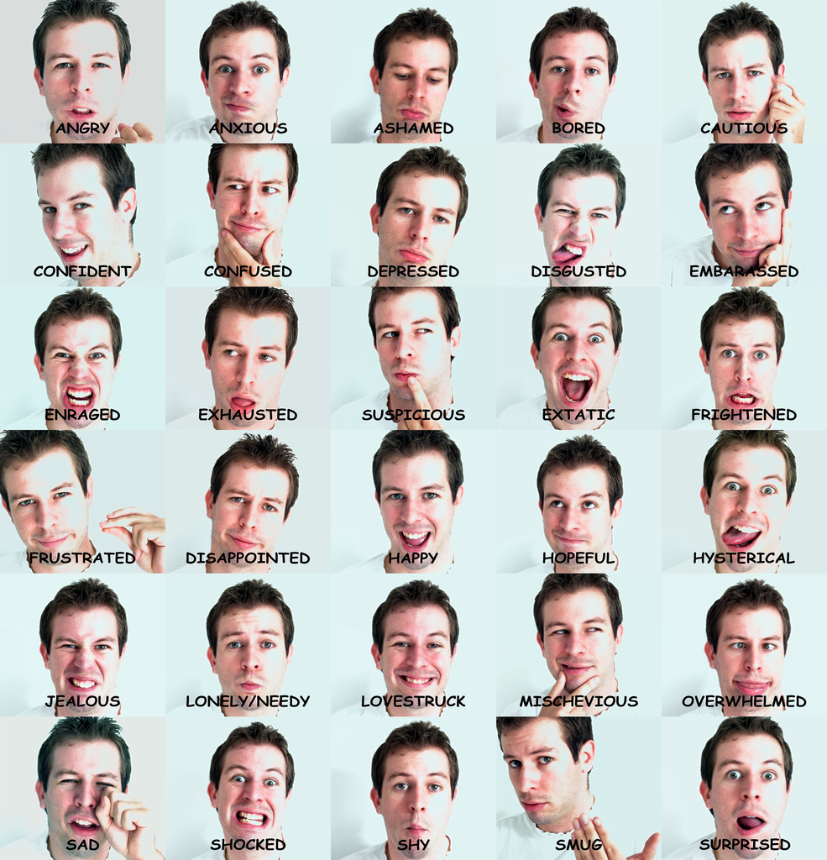

Slide 8
Types of Emotions
Affection, Anger, Angst, Anguish, Annoyance, Anxiety, Apathy, Arousal, Awe, Boredom, Confidence, Contempt, Contentment, Courage, Curiosity, Depression, Desire, Despair, Disappointment, Disgust, Distrust, Dread, Ecstasy, Embarrassment, Envy, Euphoria, Excitement, Fear, Frustration, Gratitude, Grief, Guilt, Happiness, Hatred, Hope, Horror, Hostility, Hurt, Hysteria, Indifference, Interest, Jealousy, Joy, Loathing, Loneliness, Love, Lust, Outrage, Panic, Passion, Pity, Pleasure, Pride, Rage, Regret, Relief, Remorse, Sadness, Satisfaction, Self-confidence, Shame, Shock, Shyness, Sorrow, Suffering, Surprise, Terror, Trust, Wonder, Worry, Zeal and Zest

Slide 9
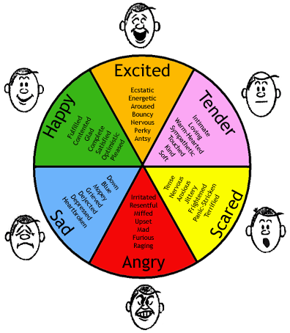
Basic Emotion
Fear and Anxiety
Anger
Sadness and Depression
Joy and Elation
Disgust
Trust
Anticipation
Surprise

Slide 10
Robert Plutchik's theory says that the eight basic emotions are
Fear → feeling afraid. Other words are terror (strong fear), shock, phobia
Anger → feeling angry. A stronger word is rage.
Sadness → feeling sad. Other words are sorrow, grief (a stronger feeling, for example when someone has died) or depression (feeling sad for a long time). Some people think depression is a different emotion.
Joy → feeling happy. Other words are happiness, gladness.
Disgust → feeling something is wrong or dirty
Trust → a positive emotion; admiration is stronger; acceptance is weaker
Anticipation → in the sense of looking forward positively to something which is going to happen. Expectation is more neutral.
Surprise → how one feels when something unexpected happens

Slide 11
Components of Emotion
Cognitive appraisal: provides an evaluation of events and objects
Bodily symptoms: the physiological component of emotional experience
Action tendencies: a motivational component for the preparation and direction of motor responses.
Expression: facial and vocal expression almost always accompanies an emotional state to communicate reaction and intention of actions
Feelings: the subjective experience of emotional state once it has occurred

Slide 12
Bodily Changes in Emotion
External bodily changes
Changes in facial expression
Changes in bodily postures
Changes in vocal expression
Internal bodily changes
Change in blood pressure
Chemical changes in blood
Changes in the rate of respiration
Changes in heart beat and pulse beat
Changes in gastrointestinal activities
Changes in galvanic skin reaction
Changes in brain waves

Slide 13
The Common-Sense Theory of Emotion
Stimulus
(Tiger)
Perception
(Interpretation
of stimulus--
danger)
Emotion
(Fear)
Bodily
Arousal
(Motivation)
(Pounding heart)
Common sense might suggest that the perception of a stimulus elicits emotion which then causes bodily arousal
Notes:
Keywords:

Slide 14

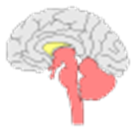


Common sense theory
Common Sense theory
An emotion - provoking stimulus produces the feeling of an emotion, and then this feeling produces physiological changes and behavior.
Fear

Slide 15
Theories of Emotion
The major theories of emotion can be grouped into three main categories:
physiological,
neurological, and
cognitive.
Physiological theories suggest that responses within the body are responsible for emotions. - James-Lange theory
Neurological theories propose that activity within the brain leads to emotional responses. - Cannon-Bard theory
Finally, cognitive theories argue that thoughts and other mental activity play an essential role in the formation of emotions. - Schater-singer theory

Slide 16
The James-Lange Theory of Emotion
The James-Lange theory is one of the best-known examples of a physiological theory of emotion. Independently proposed by psychologist William James and physiologist Carl Lange.
This theory suggests that emotions occur as a result of physiological reactions to events.
According to this theory, an external stimulus that leads to a physiological reaction.
For example: Your emotional reaction is dependent upon how you interpret those physical reactions.

Slide 17
James-Lange Theory
James-Lange Theory
An emotion-provoking stimulus directly produces physiological changes and behavior, and then these events produce the feeling of an emotion.
Fear

Slide 18
The Cannon-Bard Theory of Emotion
This theory states that we feel emotions based on physiological reactions such as sweating, trembling and muscle tension simultaneously.
More specifically, it is suggested that emotions result when the thalamus sends a message to the brain in response to a stimulus (neurological), resulting in a physiological reaction.
The incident triggering stimulus and the body's arousal take place simultaneously.

Slide 19


Cannon-Bard Theory
Cannon-Bard Theory
An emotion-provoking stimulus activates a brain center called the “thalamus”, which simultaneously sends messages to the cortex, producing the feeling of an emotion, to the viscera, producing arousal, and to the skeletal muscles, producing behavior.
Fear

Slide 20
The Schachter-Singer Theory of Emotion
Stanley Schachter and Jerome Singer proposed the theory which suggests that physiology and cognitions create emotions.
Emotions have two factors–physical arousal and cognitive label.
Also known as the two-factor theory of emotion. And it is an example of a cognitive theory of emotion.
This theory suggests that the physiological arousal occurs first, and then the individual must identify the reason behind this arousal in order to experience and label it as an emotion.

Slide 21

Schacter-Singer Theory
Schacter-Singer Theory
We have the feeling of an emotion when two factors are present: we are physiologically aroused, and we interpret that arousal in terms of a specific emotion based on the situation we are in.
“Scary dog”
Fear

Slide 22
Thank you

